Slide 1
Smart Lightning For Roads
Made By:- Shreyansh Gairola(76)
Anant Raj(87)
Submitted To:- Sachin Sharma Sir

Slide 2
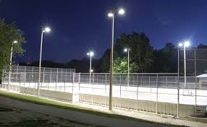
Use
‌Energy Efficient And No Human Interaction Needed

Slide 3
‌Components Used
‌Arduino Uno
Ir Sensor
ldr(PhotoResistor)
1K Resistor
Esp8266
Led
Breadboard
Jumper Wire

Slide 4
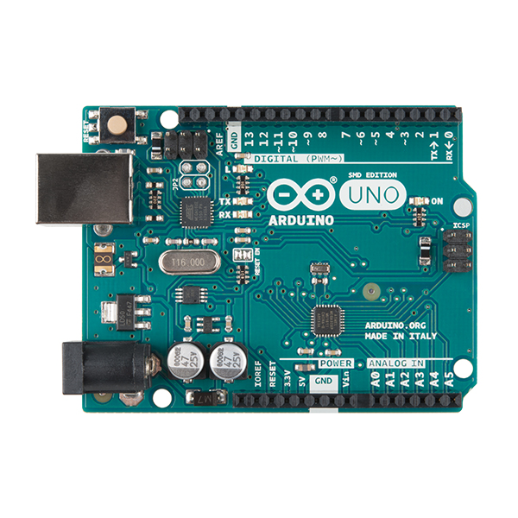
Arduino UNO
‌The Arduino UNO is an open-source microcontroller board.

Slide 5
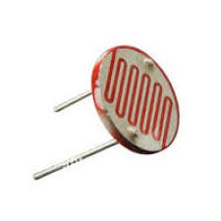
LDR
‌Ldr(PhotoResistor) is a light-controlled variable resistor.

Slide 6
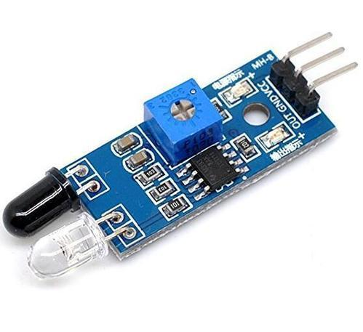
Ir Sensor
‌It emits Rays in order to sense some aspects of the surroundings.

Slide 7
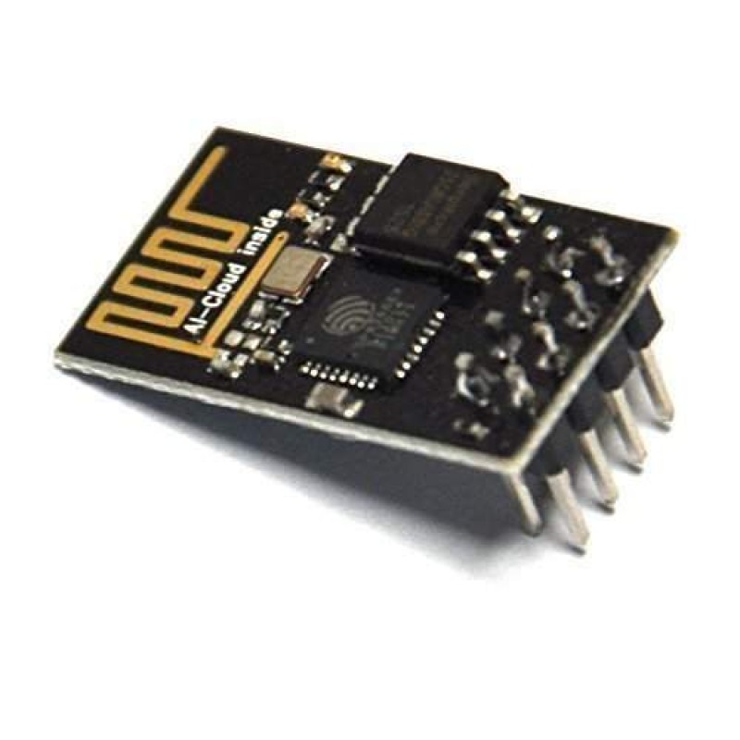
ESP8266
‌The ESP8266 is a low-cost Wi-Fi microchip with full TCP/IP stack and microcontroller capability

Slide 8
ThingSpeak
‌ThingSpeak is an open source Internet of Things application and API to store and retrieve data from things using the HTTP protocol over the Internet or via a Local Area Network
Ldr Value
Number of Cars

